Slide 1

Advanced Software Engineering CSC-580
Week 7

Slide 2
Advanced Software Engineering CSC-580
Lecture 7
What we will cover: Finish OO Analysis with Dynamic Modeling

Slide 3
Dynamic Modeling
Now we want to build a dynamic model
This dynamic model will provide us details into the actual messages that are being transferred between the objects
Initially we will have rough definitions of these messages, but as we move thru to the design of the software they will be detailed further
The behavioral model indicates how software will respond to external events or stimuli.

Slide 4
Steps to Creating the Behavioral (Dynamic) Model
Evaluate all use-cases to fully understand the sequence of interaction within the system.
Identify events that drive the interaction sequence and understand how these events relate to specific objects.
Create a Sequence Diagram for each use-case.
Build State Diagrams as needed to model the behavior within any of the objects that must generate a message.
Review the behavioral model to verify accuracy and consistency.

Slide 5
The Sequence Diagram
The sequence diagram adds the dynamic information missing in the Class Diagrams shown earlier
The textbook defines a relatively complex Sequence Diagram
Again, I think it is better to simplify things a little and only show the messages on this diagram.
Show the state diagrams that generate the output messages from input messages on separate diagrams (to follow)
Therefore, our Sequence Diagram will have:
Objects
Messages (solid arrow is message)
Returns (return messages dashed is response, if needed))

Slide 6
The Sequence Diagram II
Our Sequence Diagram will have:
Objects
Messages (solid arrow is message)
Return messages (return messages dashed is response, if needed))
Durations
Message 1
objects
Return

Slide 7
Overview of the Sequence Diagram
Object 1
Object 2
Object 3
Object 4
Message 1
External
Stimulus
Message 2
Message 3
Return
First draw the objects and the order and the message arrows, and
then fill in the actual possible message names.

Slide 8
Example of a Sequence Diagram
0..15
1..5
Recall the student
course association:
Student
Course
takes
For a student to add
a course the sequence
diagram could be:
Add/Drop
Screen
Student
Transcript
Student Schedule
Catalog
Course
Get_courses()
External
Stimulus:
Student at
PC
eval_transcript()
AddCourse()
Transcript
Eval returned
AddCourse()
Course Added
Message

Slide 9
More on the Sequence Diagram
Internally to the course there should be some logic to decide if student can take class
e.g. meets pre-reqs, section is not full, etc.
We model this with State Diagrams (next)
They will provide a means for modeling the decision logic that takes place within the methods of the various classes we are designing

Slide 10
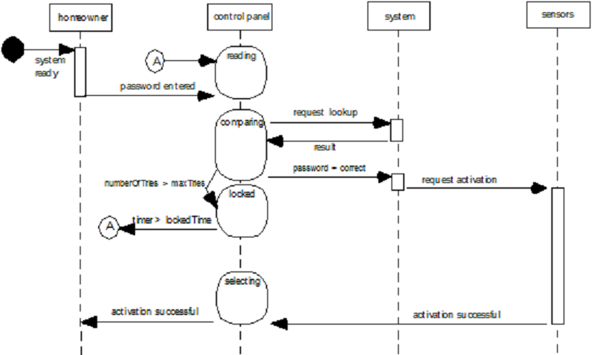
Sequence Diagram – Safehome Security

Slide 11
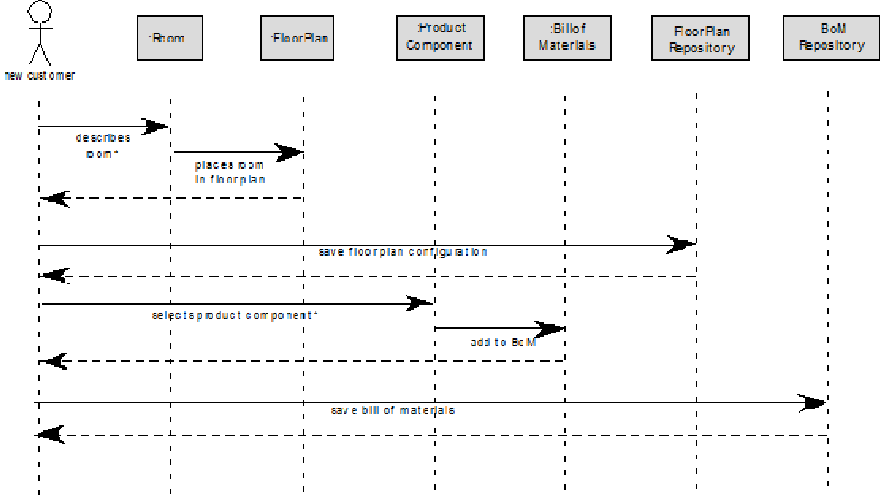
Sequence Diagram – Select Components

Slide 12
State Representations
In the context of behavioral modeling, two different characterizations of states must be considered:
the state of each class as the system performs its function and
the state of the system as observed from the outside as the system performs its function

Slide 13
State Representations II
The state of a class takes on both passive and active characteristics [CHA93].
A passive state is simply the current status of all of an object’s attributes.
The active state of an object indicates the current status of the object as it undergoes a continuing transformation or processing.

Slide 14
The States of a System
State —a set of observable circum-stances that characterizes the behavior of a system at a given time
State transition —the movement from one state to another
Event —an occurrence that causes the system to exhibit some predictable form of behavior
Action —process that occurs as a consequence of making a transition

Slide 15
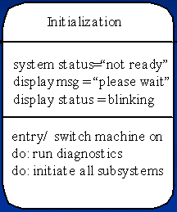
The Elements of the State Diagram
State Name
State
Variables
The three elements
of a state diagram:
Activities:
-Entry
-Actions
-Exit
Event
Additional
symbols:
Start
Exit

Slide 16
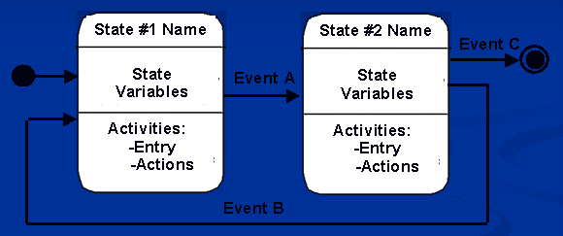
The Elements of the State Diagram

Slide 17
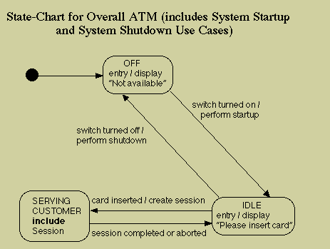
Example without Details on State Variables and Actions
http://www.math-cs.gordon.edu/courses/cs211/ATMExample/Statecharts.html

Slide 18
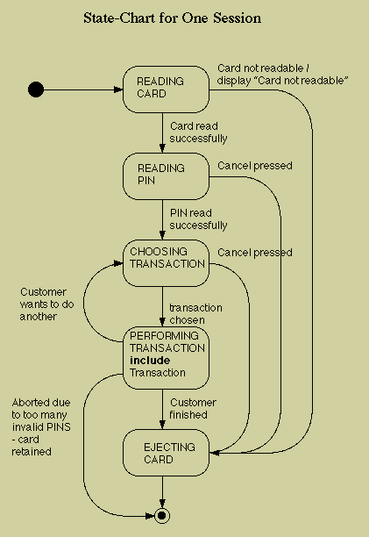
Example without Details on State Variables and Actions

Slide 19
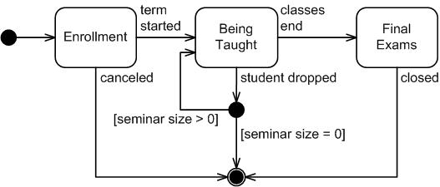
Another Example without Details on State Variables and Actions
http://www.agilemodeling.com/artifacts/stateMachineDiagram.htm

Slide 20
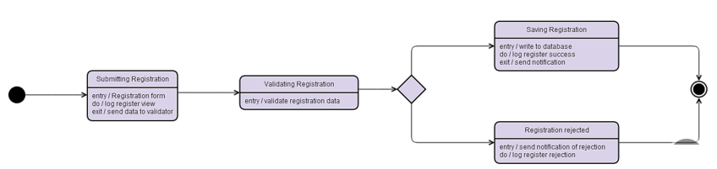
Example with Details on State Variables and Actions
https://www.gliffy.com/examples/uml

Slide 21
State Diagram for the Control Panel Class

Slide 22
Process for Making State Diagrams
Determine the states the system can be in
Connect states together
Define events that will take place to transition between states
Refine and add any states you forgot
As needed define entry conditions, actions, and any data variables that will be changed.

Slide 23
In-Class Breakout Session
Using the Coffee Shop Exercise:
Develop a Sequence Chart
Develop a State Diagram

